Slide 1


Slide 2


Migrating Web Apps to Azure App Services
Kristina Halfdane, Sr. Engineering Manager
Gaurav Seth, Sr. Program Manager

Slide 3
Agenda
Azure Migrate – Unified Web App Discovery and Assessment
PowerShell Script based Migration
App Service Migration Assistant Tools
Azure Migrate – App Containerization

Slide 4

Azure Migrate – Unified Web App Discovery and Assessment(Preview)

Slide 5


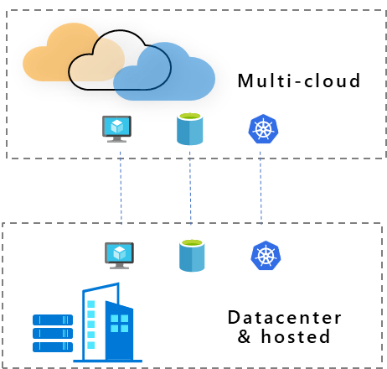
(New) At scale discovery, and assessment of web apps (ASP.NET on IIS)
Assessment for Azure VMware Solution (AVS)
Azure Migrate
Discovery, software inventory, dependency mapping, assessment, and migration capabilities for servers.
At scale discovery and assessment of SQL instances & databases

Slide 6
Supported versions & pre-requisites
VMware
Host requirements
ESXi hosts version (5.5 or later)
vCenter requirements
vCenter Server version (5.5, 6, 6.5, 6.7, 7)
Read-only account
Server requirements
Windows Server 2008 R2 and above
Read only guest user account for software inventory (discovery of installed applications)
Web apps requirements
Operating systems: Windows Server OS
Web server Version: IIS 7.5 and above
Access: Local admin access on server for collecting configuration data
Application framework: ASP.NET

Slide 7
At Scale Discovery
Support for ASP.NET web apps hosted on IIS web servers deployed on VMware environment
Perform bulk discovery of IIS web servers using Azure Migrate appliance
Discovered server dashboard displays list of IIS web servers and underlying VM infra details
If IIS web server discovery has failed then error message, possible causes and suggested remediation actions are displayed to help troubleshoot

Slide 8
At Scale Assessment
Allows bulk assessment of web apps based on user defined properties like region, isolation required, offer type and Reserved Pricing
Assess every individual web app against set of predefined configuration readiness checks like multiple app pools, authentication type, ports etc.
Provides list of apps that are ready for migration , ready with conditions and not ready for migration
Provides suggested App Service SKU for migration ​
Provides monthly cost estimates
Provides ability to review individual web app assessment result

Slide 9
PowerShell Script based Migration (Preview)

Slide 10
Support for ASP.NET web apps hosted on IIS 7.5+ web servers
No product installation needed, just copy the scripts
Perform bulk assessment of sites on a local or remote IIS web server using PowerShell remoting
Option to package sites and move them to alternate server for deployment step
Deploy multiple sites in single scripted operation, including override to migrate sites with issues

Slide 11
App Service Migration Assistant Tools

Slide 12
Run a scan on your web app’s public URL for a report of the technologies it uses and whether App Service fully supports them. If compatible, you’ll be guided to download the migration assistant to simplify your migration
Download the App Service migration assistant—a fast, free, and automated way to migrate web apps with minimal or no code changes. Run readiness checks and get potential remediation steps for common issues. Receive step-by-step guidance for moving your web app to App Service.
Standalone ASP. Net web app migration tool to App service already
Standalone Java tomcat web app migration tool to App Service Linux (Public Preview​)

Slide 13
Azure Migrate – App Containerization(Preview)

Slide 14




Containerize and Migrate your apps
Point and Containerize
Parameterize configurations
Reusable artifacts
Customization
Convert apps to container images with minimal to no code changes
Parameterize application configurations such as connection strings
Download generated artifacts Dockerfiles, Kubernetes manifests
Ability to customize at every step of the way

Slide 15


App Containerization: Supported versions & pre-requisites
ASP.NET
Java web apps
App requirements
Microsoft .NET framework
version 3.5 or later
Internet Information Services (IIS)
version 7.5 or later
App server requirements
Microsoft Web deploy tool installed
PowerShell remoting enabled
Local/domain administrator account
App requirements
Apache Tomcat
version 8.0 or later
Java Development Kit
version 7.0 or later
App server requirements
SSH remoting enabled
Root account
Supported VMs
Ubuntu Linux 16.04/18.04/20.04
Debian 7/8
CentOS 6/7
Red Hat Enterprise Linux 5/6/7.
Supported VMs
Windows Server 2008 R2 and above

Slide 16
Demo
Kristina Halfdane

Slide 17
Resources
Azure Migration Tools
https://azure.microsoft.com/en-us/services/app-service/migration-assistant/
Azure Migrate: App Containerization
https://aka.ms/AzureMigrate/Containerize
Azure Migrate: At Scale Discovery & Assessment ASP. Net Web Apps
https://azure.microsoft.com/en-us/blog/discover-and-assess-aspnet-apps-atscale-with-azure-migrate/

Slide 18

Thanks for joining!

